Slide 1

Unit-4 Non-Linear Data Structure Tree
Data Structures (DS)
DU # 2304CS411
Prof. Umesh Thoriya
Department of Computer Science & Engineering
umesh.thoriya@darshan.ac.in
9714233355

Slide 2
Topics to be covered
Introduction of Non-Linear Data Structure
Graph Notations
General Tree
Conversion of General Tree to Binary Tree
Conversion of Forest to Binary Tree
Binary Search Tree
Binary Search Tree Operations-Insertion, Deletion, Searching, Traversal
Tree Traversal - Preorder, Inorder, Postorder
Application of Tree

Looping

Slide 3
Introduction of Non-Linear Data Structure
Section-1

Slide 4
Introduction of Non-Linear Data Structure
Non-Linear Data Structure
Non-linear data structures are those data structure in which data items are not arranged in a linear sequence.
Example-Tree, Graph
Tree
Tree is a hierarchical structure where the root node have a child node and further this hierarchy may be extended up to required level which are logically connected in such a way that there is no loop.
Graph
Graph is a collection of nodes (Information) and connecting edges (Logical relation) between nodes.
8
10
4
12
7
12
5
7
10
5
9
15

Slide 5
Graph Notations
Section-2

Slide 6
Graph Notations
A tree is defined as a finite set of one or more elements (Nodes) such that,
There is one special node called root (R).
The remaining nodes are divided into N (N>0) disjoint sets named as T1, T2, T3,…, TN such that each T1 itself is tree.
Each element of the tree is known as a node. The set of T1, T2,…,TN are called sub-tree of root (R).
A is root and the tree has two sub-trees, where roots are B and C. Node B is called the left sub-tree and C is called the right sub-tree.
So, the tree is a collection of nodes and each node is connected with another node with the help of an edge.
The nodes are connected in such a way that there is no loop.
A tree with no node is called an empty tree or NULL tree.
Root Node
Edge
A
Left
Sub-Tree
Right
Sub-Tree
B
C
D
E
F
G

Slide 7
Graph Notations
Node: The individual element of the tree/graph is known as Node. It contains two parts: data and link part.
Isolated Node: A node which is not adjacent to any other node is called an isolated node.
Degree: The degree of a node is equal to the number of children that a node has.
Edge: Edge is the connection of two nodes.
Root Node
Edge
A
B
C
D
E
F
G
In-Degree: In-degree of a node is the number of edges arriving at that node. The root node is the only node that has an in-degree zero.
Out-Degree: Out-degree of a node is the number of edges leaving that node.
Leaf (Leaves): The node for which out-degree is zero or The nodes which do not have any child nodes are called leaf nodes.

Slide 8
Graph Notations
Root Node
Level 0
Edge
A
1
Level 1
B
C
2
Height = 3
Level 2
D
E
F
G
3
Depth = 2
Level: The distance between two nodes is represented as a level.
Path: A sequence of continuous edges is called a path.
Depth: The maximum level number is called the Depth of the tree.
Height: The total number of different levels available in a tree is known as the Height of a tree.

Slide 9
Graph Notations
Weight: The total number of leaf nodes available in a tree is known as the weight of a tree.
Sibling: All the nodes that are at the same level and share the same parent are called siblings.
Forest: A forest is a set of disjoint trees. If we remove the root node then we obtain a set of disjoint trees.
B
C
A
Sibling
D
E
G
B
C
F
D
E
F
G
Weight = 4

Slide 10
Graph Notations
M-array tree: The out-degree of every node is less than or equal to M then the tree is called an M-array tree.
Directed Edge: The edge which is directed from one end to another end is called a directed edge.
Undirected Edge: The edge which has no specific direction is called undirected edge.
Ancestor nodes: Ancestors of a node are all the nodes along the path from the root to that node.
Descendant nodes: Descendants of a node are all the nodes along the path from that node to the leaf node.
Root Node
A
B
Directed Edge
B
C
G
D
F
D
E
E
K
H
J
I
B
Undirected Edge
D
E

Slide 11
Binary Tree
Tree is called Binary Tree, if each and every node can have most two branches.
A binary tree is a special type of tree data structure in which every node can have a maximum of 2 children.
One is known as a left child and the other is known as right child.
Root Node
A
B
C
D
G
E
J
K
I

Slide 12
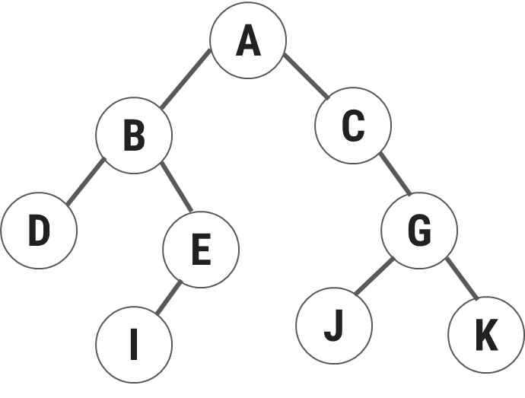


Binary Tree
A
B
C
M
D
G
E
J
K
I

Slide 13
Strict Binary Tree
Strict Binary Tree: It is a type of binary tree where every node has either zero or exactly two children, i.e., {0, 2}.
Root Node
A
A
A
B
C
B
C
C
B
D
D
G
E
J
G
E
J
G
E
J
K
J
K
I
Leaf Nodes

Slide 14
Complete Binary Tree
A complete binary tree is a special type of binary tree where all the levels of the tree are filled completely except the lowest level nodes which are filled from as left as possible.
Root Node
A
A
A
B
C
B
C
B
C
D
D
E
J
E
J
G
D
E
G

Slide 15
Complete Binary Tree Vs. Strict/Full Binary Tree
Feature | Complete Binary Tree | Strict/Full Binary Tree
Definition | A binary tree where all levels are fully filled except possibly the last, which is filled from left to right. | A binary tree where every node has either 0 or 2 children, no node has only one child.
Node Structure | Nodes can have 0, 1, or 2 children, with the last level filled from left to right. | Nodes have either 0 or 2 children, no node has only one child.
Leaf Nodes | All leaf nodes are as left as possible. | All leaf nodes are at the same level.
Internal Nodes | Internal nodes may have one or two children. | Internal nodes always have two children.
Applications | Used in heaps, array representations of trees, and level-order traversal. | Used in expression trees, Huffman coding, and perfect balance requirements.

Slide 16
General Tree
Section-3

Slide 17
General Tree
A general tree is a tree where each node may have zero or more sub tree.
A Binary Tree is a specialized case of a general tree where each node may necessarily have 0, 1, or 2 sub-trees.
A general tree is highly structured and has 3 sub-trees per node, which is called a Ternary Tree.
There is no upper limit on the out-degree of a node.
General trees are used to model applications such as file systems.
A
B
C
B
D
E
D
J
G
E

Slide 18
Conversion of General Tree to Binary Tree
Section-4

Slide 19
Conversion of General Tree to Binary Tree
Rules to Convert General Tree to Binary Tree:
The root of the general tree = Root node of the binary tree.
The Left child of a node in the binary tree = leftmost child of the node in the general tree.
The Right child of a node in the binary tree = Right sibling of the node in the general tree.

Slide 20
Convert any tree to Binary Tree
Every Tree can be Uniquely represented by binary tree
Let’s have an example to convert given tree into binary tree
a
a
a
b
b
f
b
f
f
c
g
d
c
d
g
j
k
c
d
g
j
k
h
j
e
e
h
i
e
h
i
i
k

Slide 21
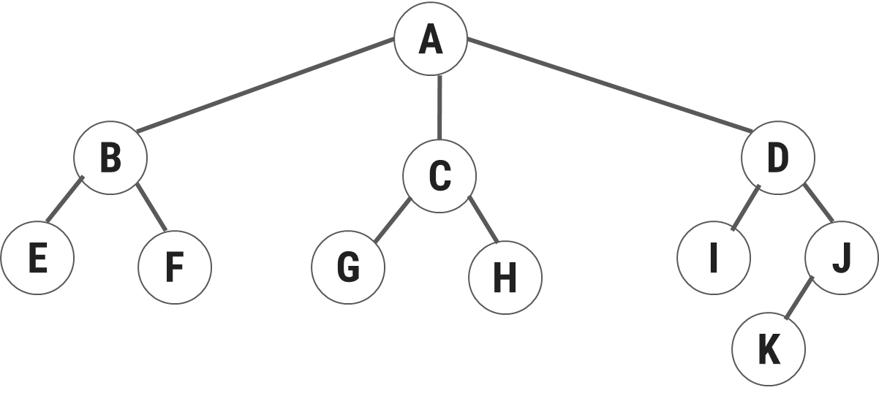
Conversion of General Tree to Binary Tree
A
B
C
D
E
F
G
H
I
J
K

Slide 22
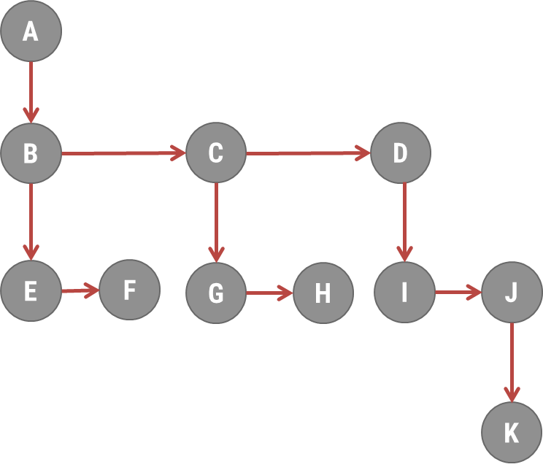

Conversion of General Tree to Binary Tree
A
B
E
C
F
D
G
I
H
J
K

Slide 23
Conversion of Forest to Binary Tree
Section-5

Slide 24
Conversion of Forest to Binary Tree
a
g
a
b
c
h
i
b
g
d
e
f
j
k
l
d
c
h
a
g
j
i
e
b
c
h
i
f
k
l
d
e
f
j
k
l

Slide 25
Binary Search Tree (BST) Operations
Section-6

Slide 26
Binary Search Tree Operations
A binary search tree is also known as an Ordered Binary Tree.
It is a variant of the binary tree in which all nodes are arranged in an order.
In a binary search tree, all the nodes in the left sub-tree have a value less than that of the root node.
Correspondingly, all the nodes in the right sub-tree have a value either equal or greater than the root node.
The same rules apply to every sub-tree.
Following operations are performed on the binary search tree:
Insertion
Deletion
Searching
Traversal

Slide 27
Binary Search Tree Operations-Insertion
To create a Binary Search Tree, it will require two stages:
Find out the appropriate location of new node.
Insert the new node into BST.

Slide 28
Binary Search Tree Operations-Insertion
Insert the following values in BST
45 68 35 42 15 64 67
Initially, binary search tree is empty.
Step 1: Insert new node 45
Step 2: Insert new node 68
Step 3: Insert new node 35
Step 4: Insert new node 42
35 < 45
45
35
68
Root Node
45
45
42 < 45
35
68
42 > 35
45
68 > 45
42
68

Slide 29
Binary Search Tree Operations-Insertion
Step 7: Insert new node 67
Step 5: Insert new node 15
Step 6: Insert new node 64
15 < 45
45
45
67 > 45
35
68
15 < 35
35
68
67 < 68
15
42
15
42
64
67 > 64
67
45
64 > 45
35
68
64 < 68
15
42
64

Slide 30
Binary Search Tree Operations-Deletion
Rules:
If the deleted node has only one sub-tree, delete the link of the parent of the deleted node to its sub-tree.
If deleted node have two sub-tree, left & right sub-tree:
Find out in order successor or next higher value in the tree of a deleted node from the entire tree.
Successor node must be placed as a child node of the parent node of the deleted node.
Delete Node 8
42
Delete Node 48
12
55
48
48
7
18
90
52
52
52
75
1
15
28
92
8
8

Slide 31
Binary Search Tree Operations-Deletion
Delete Node 12
42
Delete Node 55
12
12
55
55
7
18
52
90
75
75
15
75
15
1
15
28
92

Slide 32
Binary Search Tree Operations-Searching
First the key (value) to be searched is compared with the root node.
If it is not in the root node then we have two possibility:
If the key to be searched having a value less than the root node then we search the key in the left sub tree.
If the key to be searched having a value greater than the root node then we search the key in the right sub tree.
Algorithm: SEARCH(T, Key)
Step 1:[Check for empty tree]
if(T = NULL) then
Write (“Empty Tree”)
Exit
Step 2:[Compare key with the root node]
if(Key = DATA(T)) then
return(DATA(T))
Step 3:[Move left or right sub tree?]
if(Key < DATA(T)) then
call SEARCH(LPTR(T), Key)
else
call SEARCH(RPTR(T), Key)
Step 4:[Finished]
Exit
Search node 75
42
75
12
55
7
18
52
90
1
15
28
75
75
92

Slide 33
Binary Search Tree Operations-Traversal
Traversing means the process of visiting each node in the tree exactly once in systematic way.
There are three types of traversing techniques:
Pre- Order
In-Order
Post-Order
Assume tree node have linked allocation which is indicated as below:
LPTR | Data | RPTR
T

Slide 34
Pre-Order Traversal
In pre-order traversing following operations are performed recursively at each node.
The algorithm starts with the root node of the tree and continue by:
Visiting the root node. (V)
Traversing the left sub tree. (L)
Traversing the right sub tree. (R)
A
B
C
Pre-Order :
A
B
D
E
F
C
G
H
I
J
K
D
E
G
H
F
I
J
K

Slide 35
Pre-Order Traversal
A
B
C
D
E
G
F
A
B
D
E
C
G
F

Slide 36
In-Order Traversal
In pre-order traversing following operations are performed recursively at each node.
The algorithm starts with the root node of the tree and continue by:
Traversing the left sub tree. (L)
Visiting the root node. (V)
Traversing the right sub tree. (R)
A
In-Order :
D
B
F
E
A
G
C
L
J
M
H
K
O
B
C
D
E
G
H
F
J
K
L
M
O

Slide 37
In-Order Traversal
A
B
C
D
E
G
F
D
B
E
A
G
C
F

Slide 38
Post-Order Traversal
In post-order traversing following operations are performed recursively at each node.
The algorithm starts with the root node of the tree and continue by:
Traversing the left sub tree. (L)
Traversing the right sub tree. (R)
Visiting the root node. (V)
A
B
C
Post-Order :
D
F
E
B
G
L
M
J
O
K
H
C
A
D
E
G
H
F
J
K
L
M
O

Slide 39
Post-Order Traversal
A
B
C
D
E
G
F
D
E
B
G
F
C
A

Slide 40
Write Pre/In/Post Order Traversal
1
50
15
2
3
25
75
3
1
6
22
4
22
40
60
80
5
45
5
15
30
90
23
65
In : 2,1,4,5,3
Pre: 1,2,3,4,5
Post: 2,5,4,3,1
In: 15,22,25,30,40,50,60,75,80,90
Pre: 50,25,22,15,40,30,75,60,80,90
Post: 15,22,30,40,25,60,90,80,75,50
34
78
In: 3,5,6,15,1,22,23,34,45,65,78
Pre: 15,3,6,5,1,22,45,23,34,65,78
Post: 5,6,3,34,23,78,65,45,22,1,15

Slide 41
Construct Binary Tree from Traversal
Construct a Binary tree from the given Inorder and Postorder traversals
Step 1: Find the root node
Preoder Traversal – first node is root node
Postoder Traversal last node is root node
Step 2: Find Left & Right Sub Tree
Inorder traversal gives Left and right sub tree
Inorder : D G B A H E I C F
Postorder : G D B H I E F C A
A
Postorder : G D B H I E F C A
A
A
A
Inorder : D G B A H E I C F
B
C
B
C
A
D,G
H,E,I
F
D
E
F
D,G,B
H,E,I,C,F
G
H
I

Slide 42
Construct Binary Tree from Traversal
G
Preorder : G B Q A C K F P D E R H
Inorder : Q B K C F A G P E D H R
G
G
G
G
B
P
B
P
Q B K C F A
P E D H R
D
Q
A
D
Q
A
G
C
E
R
B
K C F
E
H R
P
K
F
H
Q
K C F A
E D H R

Slide 43
Application of Tree
Section-7

Slide 44
Application of Tree
File system : Tree is prevalent used in file system of computer where thre and multiple files and folder to locate a data and access it. The folder structure can be broken down to understand in the form of an hierarchical tree data structure
Node: Represents a directory or file.
Root: The top-level directory.
Children: Subdirectories or files.
Hierarchical Data Representation: Trees naturally represent hierarchies, making them ideal for databases, organizational charts
Networking: In network routing algorithms, spanning trees help in efficiently connecting different parts of a network without cycles.
Decision Making: Decision trees are used in AI for decision-making processes, enabling machines to simulate human-like decisions.
Geographic Data Storage: Use for efficiently handling spatial data, often in geographic information systems (GIS).

Slide 45
Data Structure (DS)
DU #2304CS411
Prof. Umesh H Thoriya
Department of Computer Science & Engineering
umesh.thoriya@darshan.ac.in
9714233355

